Slide 1


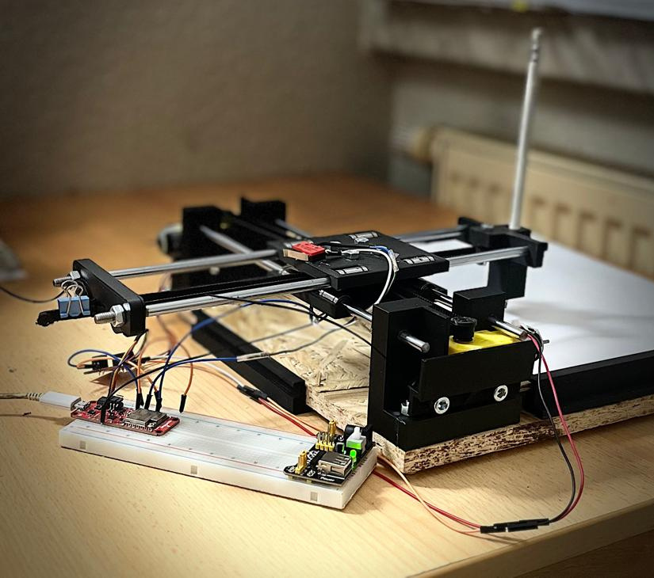
WORKSHOP MECHATRONICS TEAM - 23
MECHATRONICS AND ROBOTICS
x-y pen plotter
Two Dimentional Pen Plotter
GUIDED BY: PROF. DR. STEFAN ROTH
PROF. DR. ING-SILVIO BACHMANN
HOCHSCHULE SCHMALKALDEN

Slide 2



OVERVIEW
Organization Chart
Components
Project Goals
Mechanical Design
Project Timeline
Electrical Design
Project Tasks
Working Principle
Fun Facts
Programming
Introduction
Bluetooth-(HMI)
Pen Plotter Examples
Final Assembly
V-Model
Problem Summary
Morphological Chart
Future Scope

Slide 3


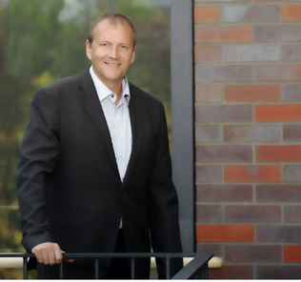





ORGANIZATION CHART
Prof. Dr.-Ing. Stefan Roth
Prof. Dr.-Ing. Silvio Bachmann
D﻿aniya
Ahmed
User requirements
Mechanical Assembly
Project Presentation
Technical specifications
Coding
Electrical Wiring
Verification Protocol & Verification Report
Validation Protocol
& Validation Report
Mechanical
Assembly
Electrical Wiring
Project Dossier
Coding
Design Specifications
CAD Design
Project Dossier
Keerthibaalan
Thiruvalluvan﻿
Mohamad S﻿ahil
Nazeer
Rathan
Prade﻿ep Kumar
Ram Charan
Vuyyala

Slide 4


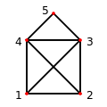

project Goals
The primary objective of the project is to create a pen plotter by integrating all the available components. These components will be responsible for controlling the movement of the pen and ensuring accurate plotting on paper.
The project team will design and fabricate the necessary parts, program the control system, and assemble the pen plotter. The following tasks will be performed:
▪ Designing and building a functional pen plotter using specific components.
▪ Ensuring precise and accurate plotting on paper.
▪ Developing a user interface to control the movement of the pen.
▪ Testing and calibrating the pen plotter for optimal performance.
▪ Demonstrating the functionality and output of the pen plotter through
plotted designs of Nikolaus Haus.
Nikolaus Haus

Slide 5

project Timeline
01
02
03
04
CAD DESIGN & FABRICATION
CODING AND USER INTERFACE LINKING
TESTING & CALIBRATION
DOCUMENTATION,
VERIFICATION & VALIDATION
(1st Sep 2023 – 10th OCt 2023)
(25th Sep 2023 – 20th OCt 2023)
(1st Nov 2023 – 22nd Nov 2023)
(1st Oct 2023 – 3rd Dec 2023)

Slide 6
Project Tasks
01
02
03
04
05
06
3D DESIGN
3D PRINTING
ASSEMBLY
ELECTRICAL DESIGN
PROGRAMMING
NIKOLAUS HOUSE
Make a two-axis motion system (X-Y Pen Plotter system).
Project work in the development of a Mechatronics system with mechanical, electronics, and control units.

Slide 7
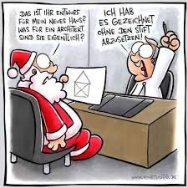
XY PEN PLOTTER
fun facts
Nikolaus House is also known as the House of Santa Claus.
The history of this drawing game is not known. But there is a saying “If you can’t do this, you won’t get a partner”.

Slide 8

XY PEN PLOTTER
Introduction
X-Y pen plotter, a mechatronic system, combines electrical, software, and mechanical components to produce text and graphical artwork.
Users can connect to the robot through a software interface developed using the Bluetooth Terminal Application, enabling control over its movements.
There are different types of X-Y Pen plotter designs available in the market.
eg. Flatbed Plotters, Drum Plotters, Sliding Bed Plotters, Vertical Plotter.

Slide 9

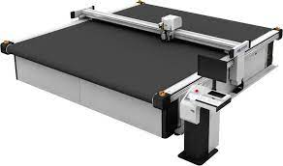
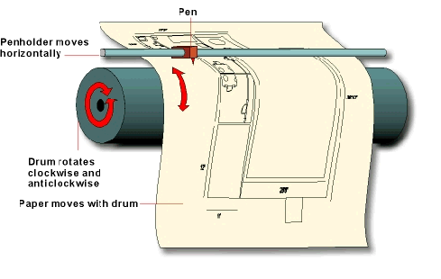
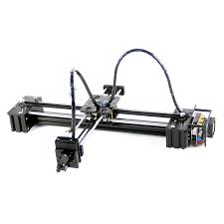
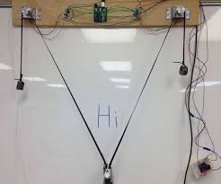
XY PEN PLOTTER
Flatbed Plotter
X-Y Plotter Examples
Drum Plotter
H-Bot Plotter
Vertical Plotter

Slide 10




V - Model
Overall System Testing:
-Validation of the operating procedure of the
Pen-plotter system
-Cycle time check
User Requirements:
-To draw the Nikolaus House using the pen plotter
-Cycle time: 30 seconds
Mechanical Requirements:
-Two-axis control to facilitate movement in both
X & Y axes -Resistance to impact load
from 0.25m height
Sub-Systems Testing:
-Testing of individual sub-system
contributing to the working of the pen-plotter
Electrical Requirements:
-2,5V DC Motor, Arduino ESP32 Control
-Quick motor drive, Limit switches
Domain-wise components testing:
-Rechecking the I.C electrical connections
-Verification of mechanical assembly
Software Requirements:
-Arduino programming of control function
-3D CAD Modelling of 3D printed components
System Integration:
-Verification of control function after iterations
-Verification of 3D modelling depending on end-result
Implementation:
Mechanical: Additional 3D components printed to support the assembly of the Pen plotter
Electrical: Arduino ESP32, Belt with 2,5V DC Motor driver, Micro USB B, Different switches
Software: Solidworks, Arduino IDE coding

Slide 11


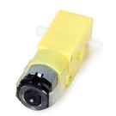
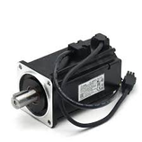
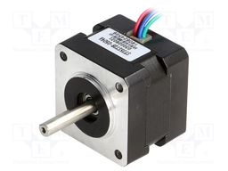
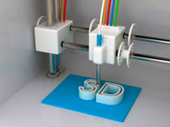
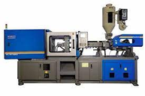

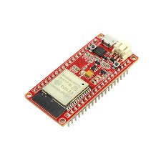
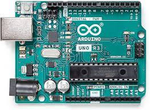
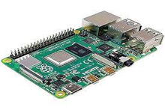
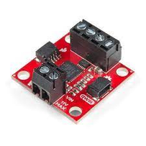
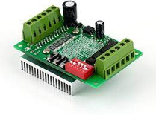
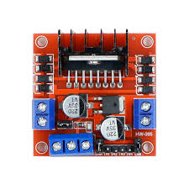
Morphological Chart
MODULES
1
2
3
Drive Module
DC Motor
Servo Motor
Stepper Motor
Fabrication
Process
3D Printing
Metal Fabrication
Injection Moulding
microcontroller
ESP32 BOARD
Arduino UNO
RASPBERRY PI
Motor driver
Sparkfun QWIIC Motor Driver
TB6560
A4988 Stepper
Motor Driver

Slide 12
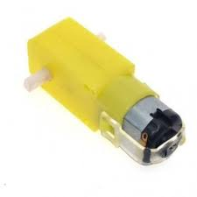
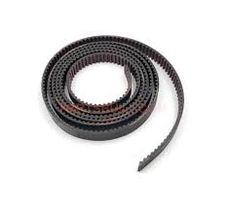
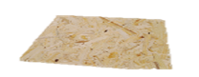

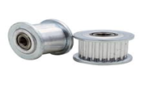
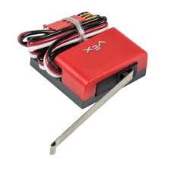
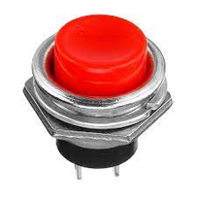
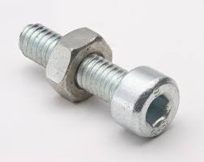
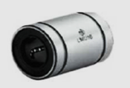
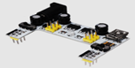
COMPONENTS
DC Geared Motor 6V
Timing Belt
Ground Plate
Microcontroller (ESP32 BOARD)
Motor Driver
Guiding Shaft
Limit switch
Motor Pulley
Push Button
Screws and Fasteners
Linear Ball Bearing
power Supply Board

Slide 13

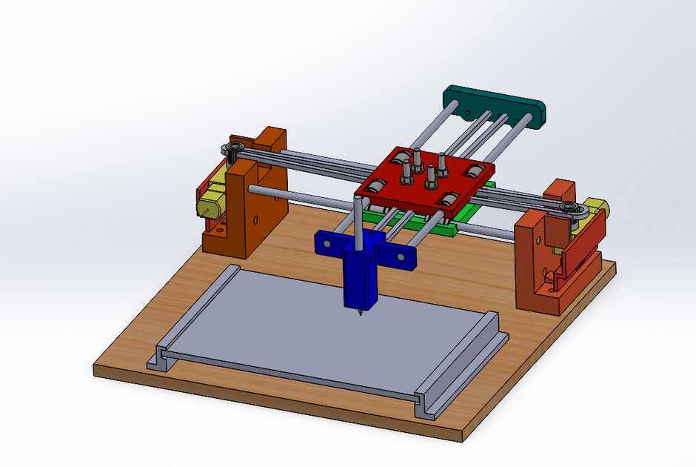

Mechanical Design
There are two axes in this, but they are not moving independently. The Y-axis mechanism is, as you can see, coupled to the X-axis mechanism. But because we can put it anywhere, this design offers versatility. So we carried out with this idea for our design.
The major aim of mechanical design is to create a
robust and functional Pen Plotter which ensures smooth & precise operation.
The following components were designed accurately by using DSS SolidWorks:
a) Frame and Structure
b) Carriage and Slides
c) Pulley and its fixtures
d) Pen Holder
Choosing the right components, materials, and mechanisms ensures that the Pen Plotter performs its intended tasks effectively and efficiently.

Slide 14
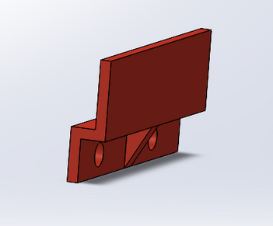
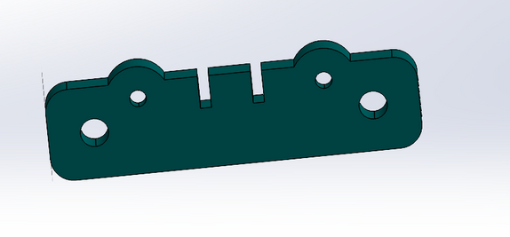
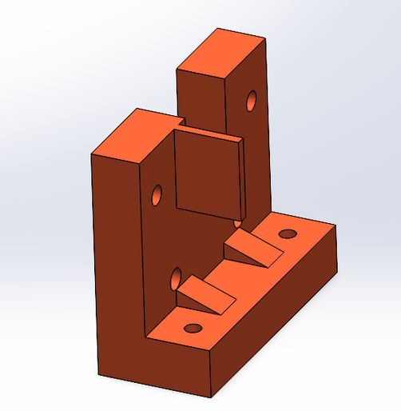
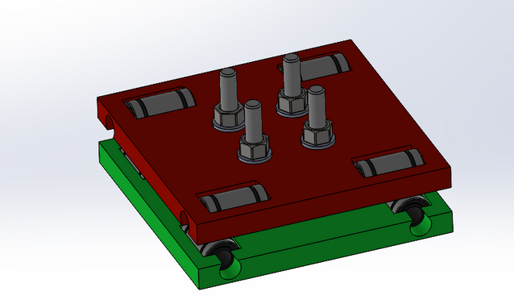
Mechanical design
Assembly of Mechanical components:
After acquiring the 3D printed components, they were used to assemble the final mechanical assembly.
To attain smooth movement between the guide rods and sliders, linear bearings were used.
Various fasteners such as M4,M5,M6 screws, washers
Reasons:
Simplicity
Less stress on Belts
Easily Programmable
No effect from Gravity (Compared to Vertical Plotter)
Less torque on motors
Minimalistic Design

Slide 15
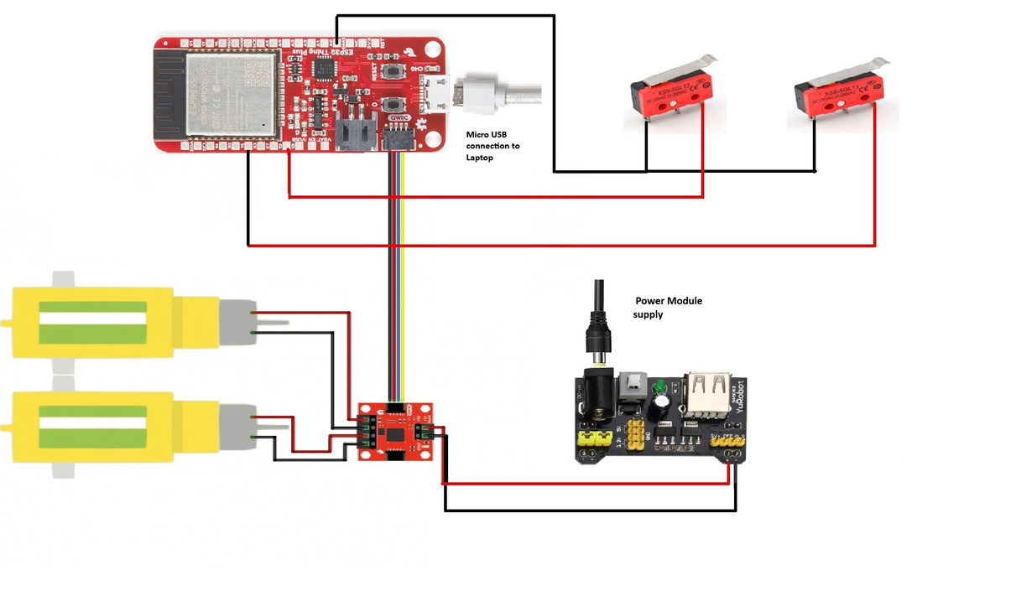

Electrical Design
As we can see in the image, it shows the electrical schematic diagram of the circuit.
Two motors are connected to the motor driver and the motor driver is connected to the ESP 32 controller.
The motor driver takes the command from the controller and the controller is connected to the Computer via USB cable.
There are also limit switches to bind the plotter in the limit.
All these connections are possible with the help of a breadboard.

Slide 16
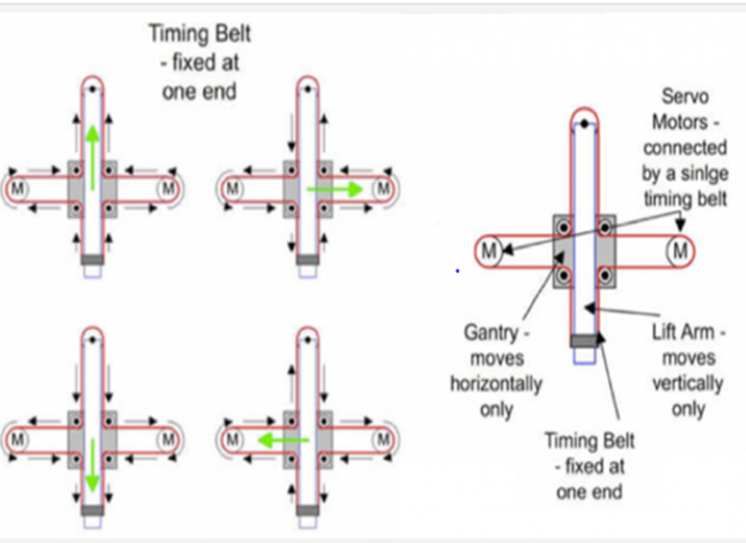
Working principle
While programming the controller in Arduino IDE software to draw Nikolaus's house, we used the image as a reference.
considering the image we have prepared the code for the Nikolaus house. With the help of these diagrams, it is very easy to code any 2-dimensional lines in the ESP 32 controller.

Slide 17


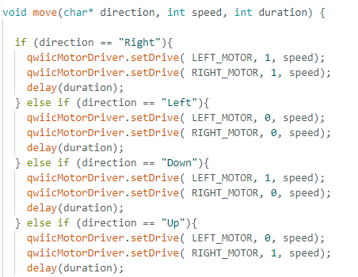
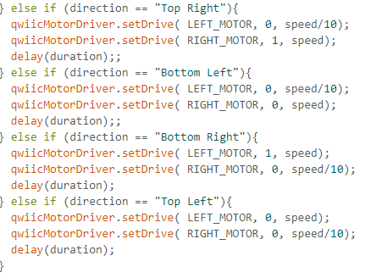
PROGRAMMING
Square Movement
Diagonal Movement

Slide 18

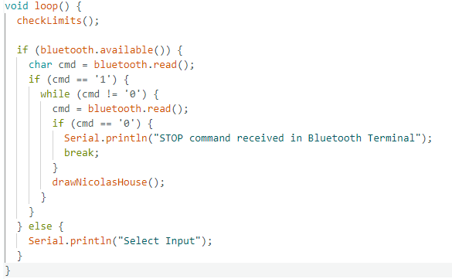


BLUETOOTH-(HMI)
SCAN FOR CODE

Slide 19
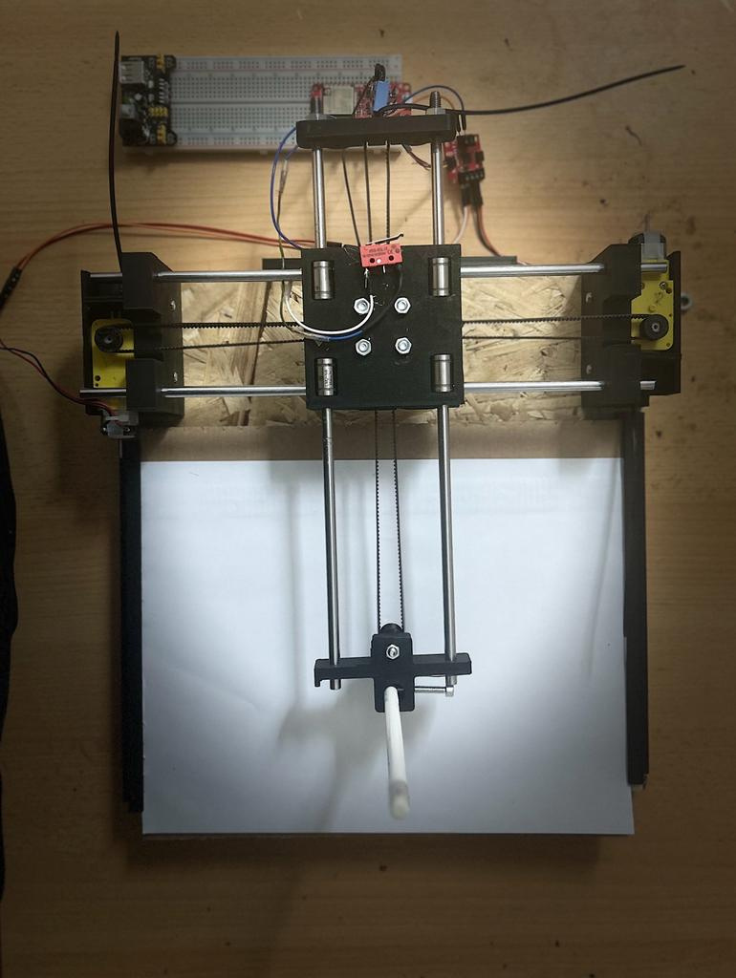
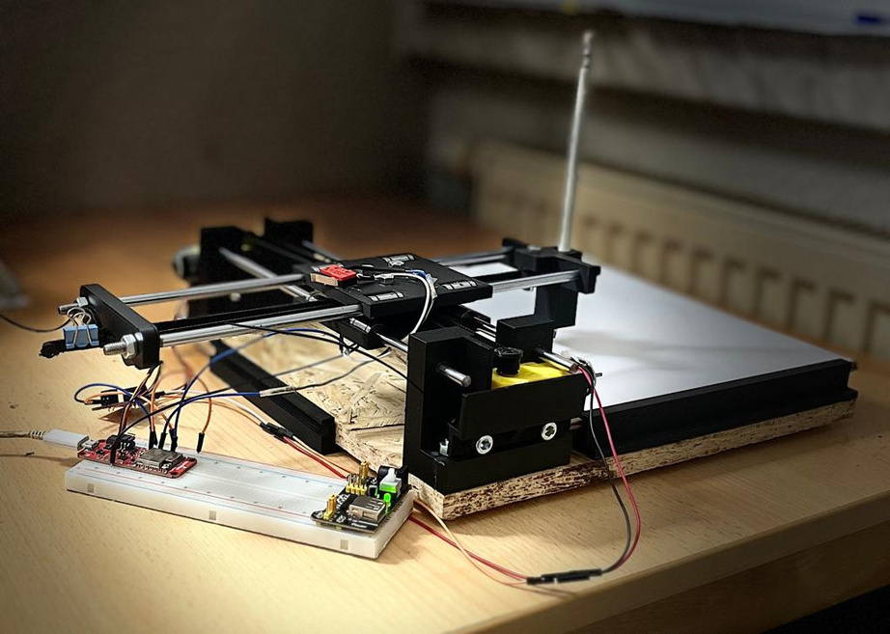
FINAL ASSEMBLY
Github.com/XY-Pen-Plotter

Slide 20
01
02
A lot of iterations to find out the Coordinates.
Motor Speed is Unreliable.
03
04
Difficulty in Integrating Software with Hardware.
Vibration in the system due to pulleys, leads to inaccurate tracing of lines
Problem Summary

Slide 21

FUTURE SCOPE
Z AXIS
SERVO MOTORS
Movable Pen in Z axis, to create legible drawings.
Using Servo Motors for Positional accuracy and precise control
SENSORS
Using Sensors to increase accuracy and flexibility.
CODING
Adaptable coding can be implemented so that the scope of the pen plotter can be extended beyond the Nikolaus House

Slide 22



Thank
You
Presented by Team # 23

